Slide 1
Introduction to the Nervous System

Slide 2
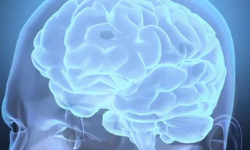
By the end of this lesson you should be able to answer the following questions:
1. | Describe the main components of the nervous system.
2. | Explain how the nervous system is involved in maintaining homeostasis.

Slide 3
Your body has an internal system in place that can sense and respond to the changes in your environment.
This is the nervous system!
Your nervous system is the main communication centre of your body. It receives, processes and responds to stimuli you get from your environment.
It is involved in controlling all of your body movements, like the muscles in your legs when you are walking, and also controls all the other important systems in your body like your heartbeat, breathing and digesting.

Slide 4
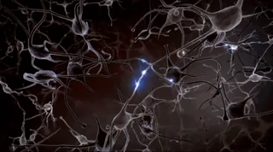
The nervous system is composed of nerve cells, called neurons.
The nervous system communicates information all around the body by sending electrical signals across these neurons. These electrical signals travel around the body extremely quickly.
The nervous system can send signals at a rate of 100 meters per second!

Slide 5

You can imagine how important it is that signals from the nervous system occur quickly.
What a problem it would be if you wanted to take a walk but had to wait for a couple of hours before the signal from your brain reached your feet!

Slide 6
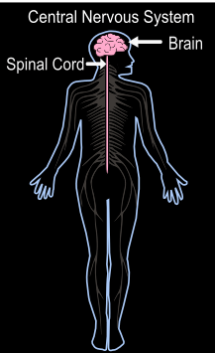
The nervous system can be divided up into two parts, the central nervous system and the peripheral nervous system.
The central nervous system is made up of the brain and the spinal cord and is the main control centre of the entire nervous system.
These organs process all of the signals they receive from the rest of the body.

Slide 7
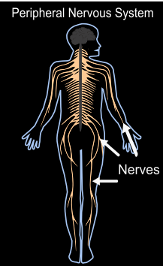
The peripheral nervous system consists of all of the nerves that are connected to all the muscles in your body.
A nerve is made up of many neurons bound together.
Nerves are like wires that sense information from the environment and connect the rest of your body back to the central nervous system and produce a response.

Slide 8
The nervous system functions by sensing, processing, and then responding to all of the information it gets, in that order.
Let's look an example of how this works. Imagine that you have a spider crawling on your hand.
Sensory receptors on your skin first sense the movement of the spider crawling on you.

Slide 9
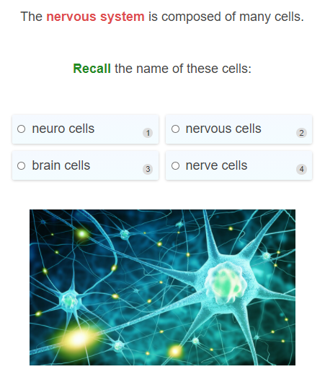

Slide 10
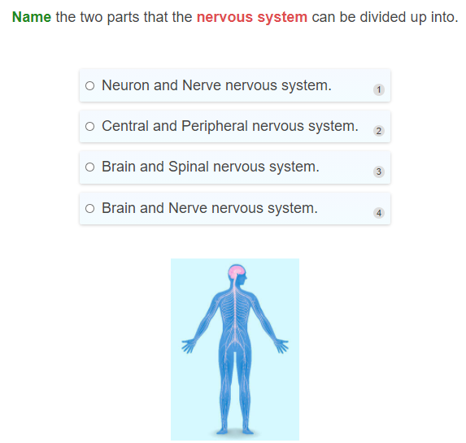

Slide 11
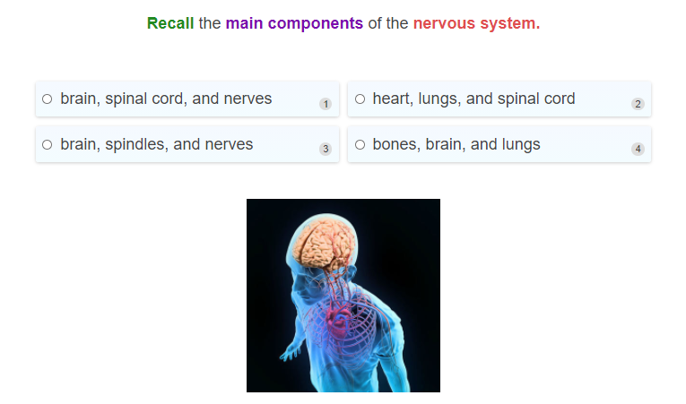

Slide 12
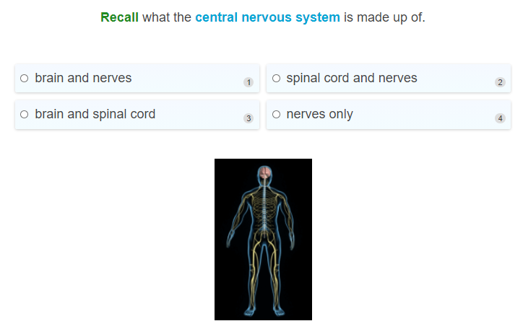

Slide 13
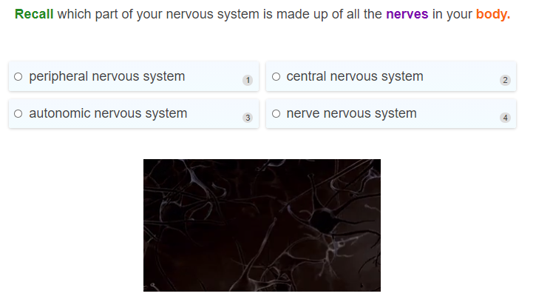

Slide 14
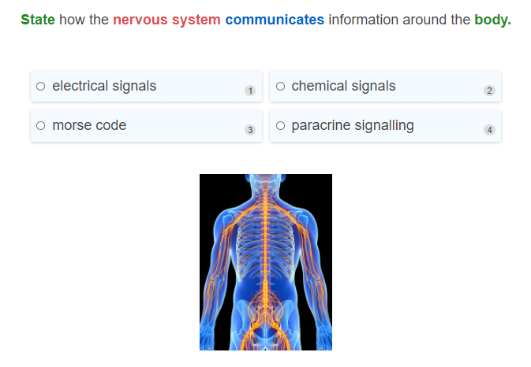

Slide 15
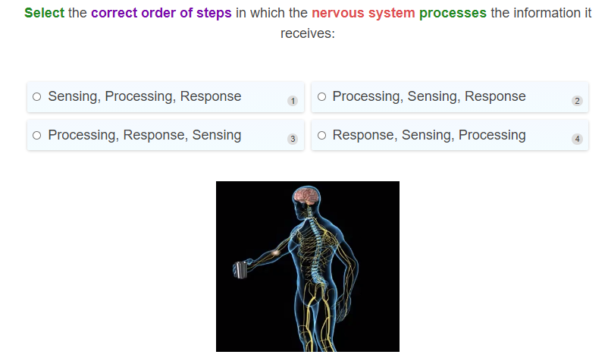

Slide 16
The receptors send a message to the nerves in your hand that go up to the spinal cord and brain, which processes this information and decides what to do with it.
This is when the brain decides what you want to do with the spider, like brush it off your hand, squish it, or run around screaming.
After processing, the brain then tells the body what to do, by sending a message down through the nerves to the muscles that will do the action, leading to a response.

Slide 17
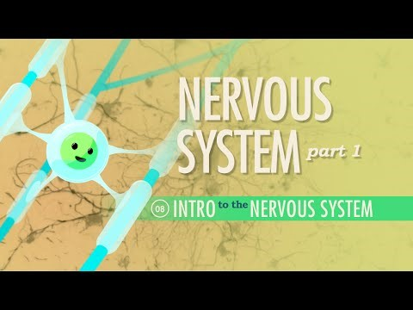

Slide 18
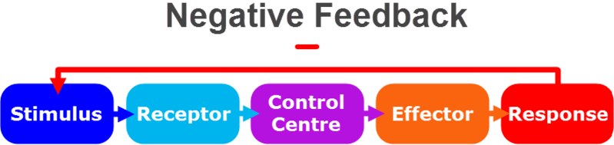
Great! We know that the main components of the nervous system are the brain, spinal cord and nerves.
Did you know that these components all work together to help your body to maintain homeostasis?
You may recall from the homeostasis lessons that homeostasis is maintained in a negative feedback loop. This means that the body responds in a way that acts against the initial stimulus to bring the body back to its original state.
The nervous system is an essential system that is involved in the steps of this pathway to ensure homeostasis.

Slide 19

Let's use regulating body temperature as an example.
The external temperature all around us is usually going to be higher or lower than 37∘C!
This means that our body has to constantly be able to sense the changes in temperature and report back to your body to make sure that a response can be made to keep an internal body temperature of 37∘C.
This example of homeostasis happens to you everyday!

Slide 20
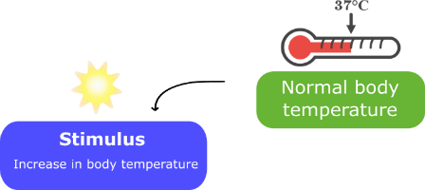
Let's take a look at the steps your body goes through to maintain homeostasis of your body temperature.
1. Imagine that it is a super hot day and the outside temperature is much higher than your internal body temperature. This can cause your internal body temperature to increase. This increase in temperature is the stimulus.

Slide 21
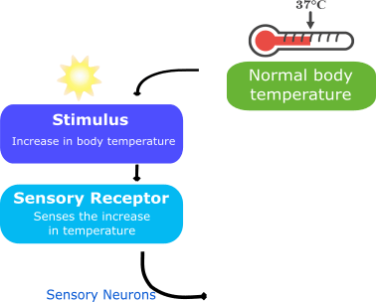
2. This is sensed by sensory receptors in your skin that send an electrical signal through your sensory neurons, a specific type of neuron, which take the message to the control centre.
Sensory neurons always take information toward the central nervous system, in other words, toward the brain and spinal cord.

Slide 22
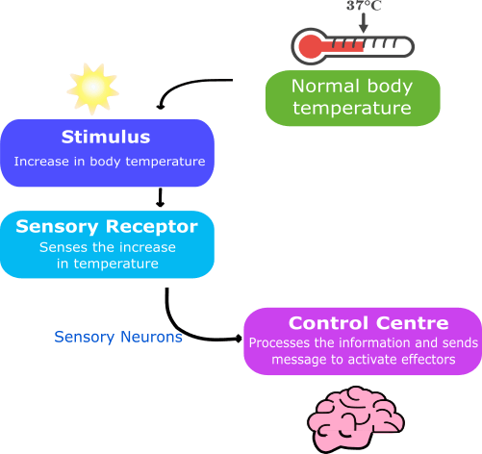
3. The brain processes the information it has received from the sensory neurons and determines what to do in order to restore the body temperature to normal.
Since the temperature is too hot outside, the body will have to activate effectors that will cool down the body.

Slide 23
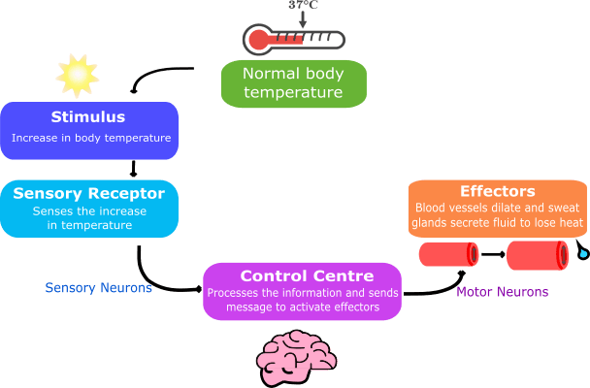
4. The brain then sends electrical signals through another type of neuron called the motor neuron which takes the signal to the effectors.
Motor neurons always take information away from the central nervous system and toward the effectors which will produce a response.

Slide 24
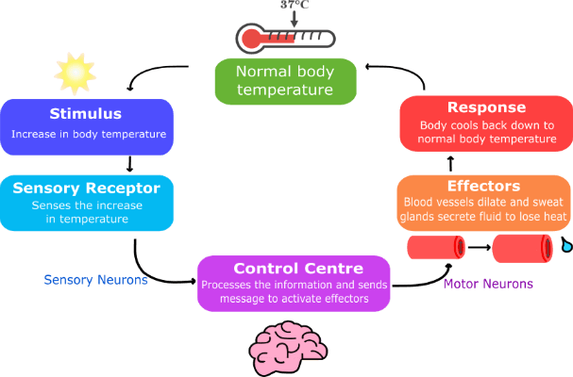
5. The effectors will produce a response which will cool the body back down to the set point, restoring normal body temperature.
In this case the effectors are the sweat glands, which produce fluid, and blood vessels, which dilate (expand), to result in heat loss and cool the body down.

Slide 25
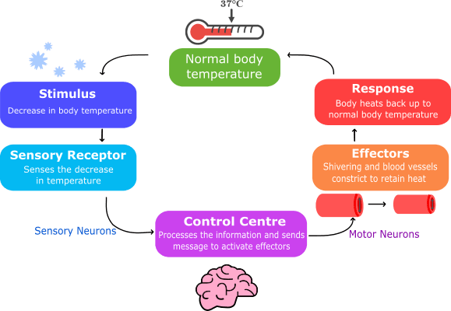
From this example you can see the involvement of the nervous system in maintaining the homeostasis of body temperature.
Of course, if there was a decrease in temperature, the nervous system would go through this same pathway, but the response would be to activate effectors which result in an increase in body temperature like constriction (narrowing) of blood vessels and shivering to restore normal body temperature.

Slide 26
The nervous system is important for maintaining homeostasis
Without the different components of the nervous system working together, like your neurons transmitting the information sensed by the receptors, the brain processing, then sending messages back to produce a response, it would be impossible to maintain a constant body temperature!
Therefore if any part of the nervous system was damaged, homestasis would be difficult or impossible to maintain!

Slide 27
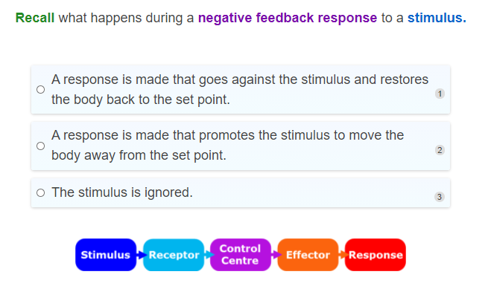

Slide 28
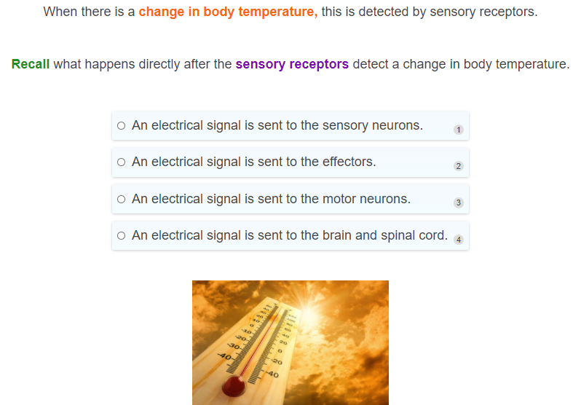

Slide 29
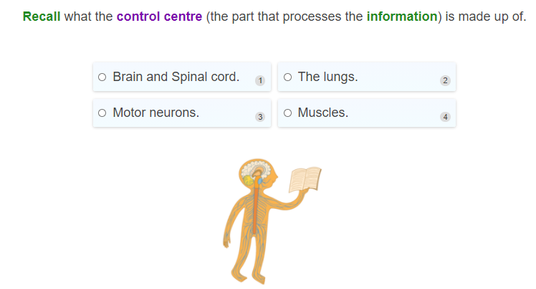

Slide 30
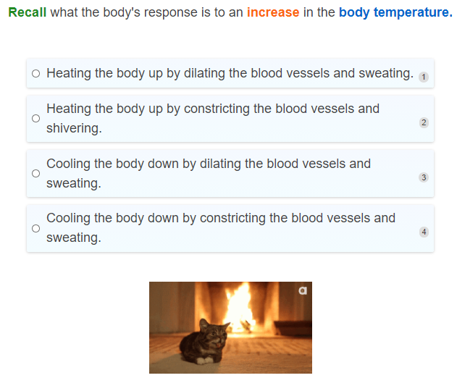

Slide 31
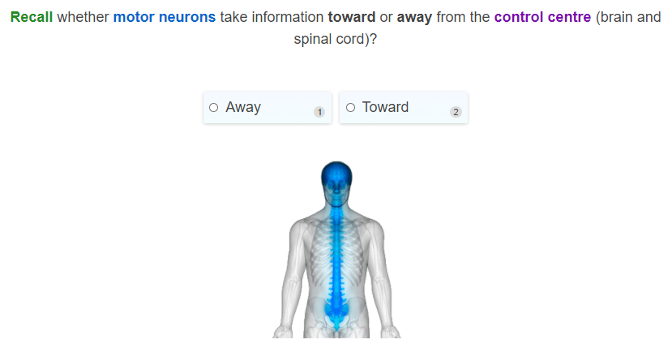

Slide 32
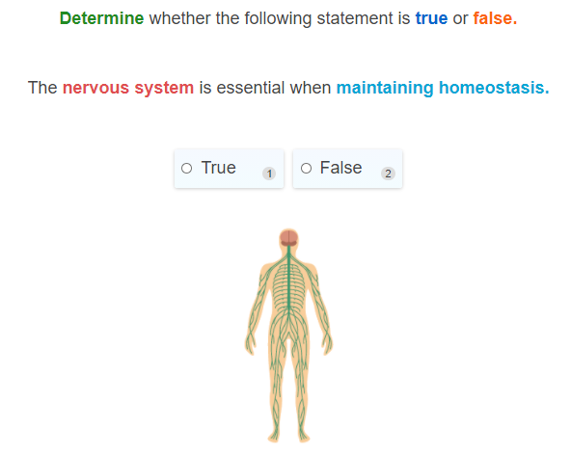

Slide 33
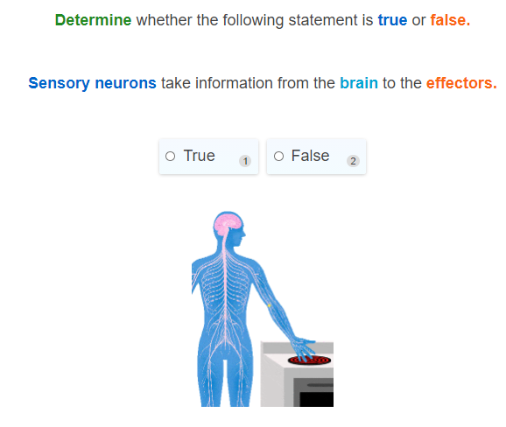

Slide 34
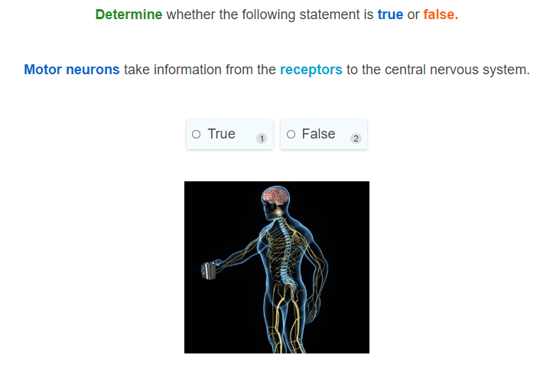

Slide 35
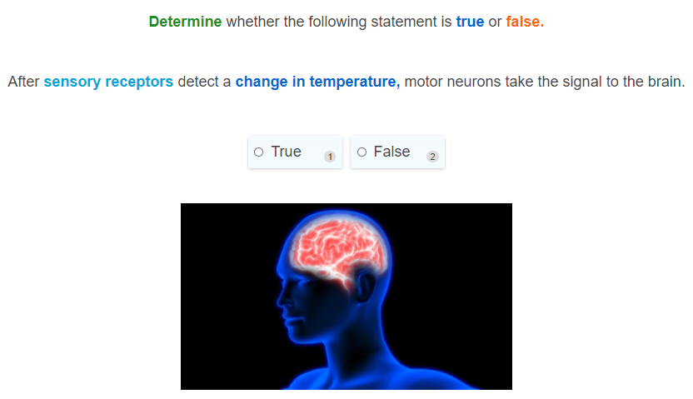

Slide 36
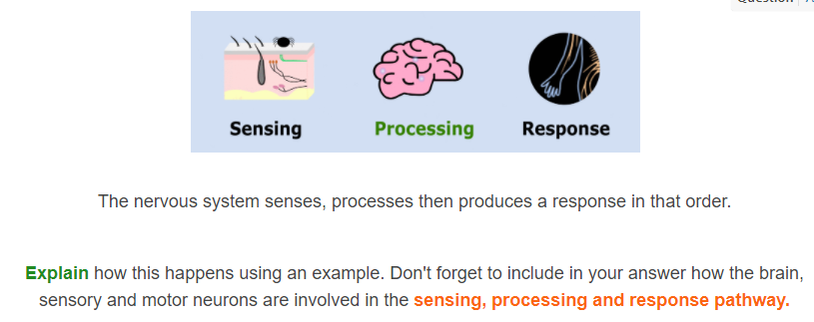

Slide 37
